Slide 1
Modern Control Systems (MCS)
Lecture-11-12
PID

Slide 2
Lecture Outline
Introduction to PID
Modes of Control
On-Off Control
Proportional Control
Proportional + Integral Control
Proportional + Derivative Control
Proportional + Integral + Derivative Control
PID Tuning Rules
Zeigler-Nichol’s Tuning Rules
1st Method
2nd Method

Slide 3
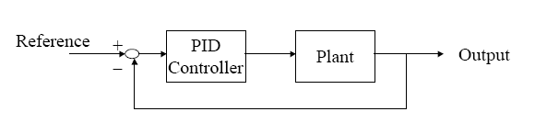
Introduction
PID Stands for
P → Proportional
I → Integral
D → Derivative

Slide 4
Introduction
The usefulness of PID controls lies in their general applicability to most control systems.
In particular, when the mathematical model of the plant is not known and therefore analytical design methods cannot be used, PID controls prove to be most useful.
In the field of process control systems, it is well known that the basic and modified PID control schemes have proved their usefulness in providing satisfactory control, although in many given situations they may not provide optimal control.

Slide 5
Introduction
It is interesting to note that more than half of the industrial controllers in use today are PID controllers or modified PID controllers.
Because most PID controllers are adjusted on-site, many different types of tuning rules have been proposed in the literature.
Using these tuning rules, delicate and fine tuning of PID controllers can be made on-site.

Slide 6
Four Modes of Controllers
Each mode of control has specific advantages and limitations.
On-Off (Bang Bang) Control
Proportional (P)
Proportional plus Integral (PI)
Proportional plus Derivative (PD)
Proportional plus Integral plus Derivative (PID)

Slide 7
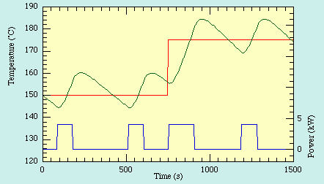
On-Off Control
This is the simplest form of control.
Set point
Error
Output

Slide 8











Proportional Control (P)
In proportional mode, there is a continuous linear relation between value of the controlled variable and position of the final control element.
Output of proportional controller is
The transfer function can be written as
$$r(t)$$
$$e(t)$$
$$K_{p}$$
$${cp(t)=K}_{p}e(t)$$
$$c(t)$$
$$Plant$$
-
$$b(t)$$
$$Proportional$$
$$Control$$
$$Feedback$$
$${cp(t)=K}_{p}e(t)$$
$${\frac{Cp(s)}{E(s)}=K}_{p}$$

Slide 9
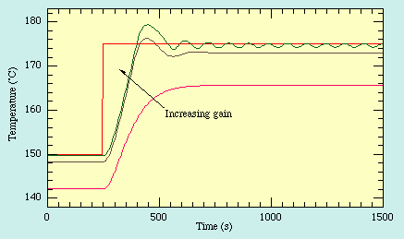
Proportional Controllers (P)
As the gain is increased the system responds faster to changes in set-point but becomes progressively underdamped and eventually unstable.

Slide 10
Proportional Plus Integral Controllers (PI)
Integral control describes a controller in which the output rate of change is dependent on the magnitude of the input.
Specifically, a smaller amplitude input causes a slower rate of change of the output.

Slide 11
Proportional Plus Integral Controllers (PI)
The major advantage of integral controllers is that they have the unique ability to return the controlled variable back to the exact set point following a disturbance.
Disadvantages of the integral control mode are that it responds relatively slowly to an error signal and that it can initially allow a large deviation at the instant the error is produced.
This can lead to system instability and cyclic operation. For this reason, the integral control mode is not normally used alone, but is combined with another control mode.

Slide 12
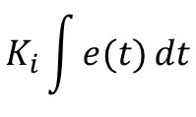

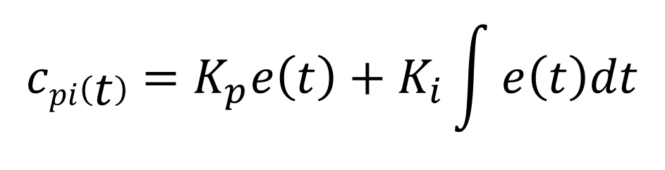

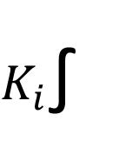







Proportional Plus Integral Control (PI)
$$K_{i}\int{e(t)}dt$$
$K_{i}$∫
+
$$r(t)$$
$$e(t)$$
$$K_{p}e(t)$$
+
$$cpi\left(t\right)$$
$$K_{p}$$
$$Plant$$
$$c(t)$$
-
$$b(t)$$
$$Feedback$$
$$cpi\left(t\right)=K_{p}e\left(t\right)+K_{i}\int{e\left(t\right)dt}$$

Slide 13
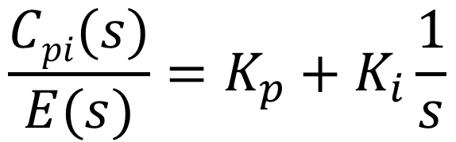
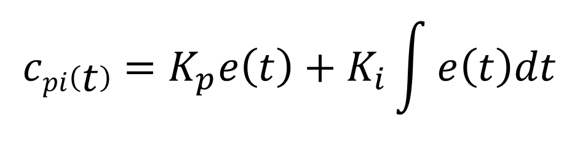
Proportional Plus Integral Control (PI)
The transfer function can be written as
$$cpi\left(t\right)=K_{p}e\left(t\right)+K_{i}\int{e\left(t\right)dt}$$
$${\frac{Cpi(s)}{E(s)}=K}_{p}+K_{i}\frac{1}{s}$$

Slide 14

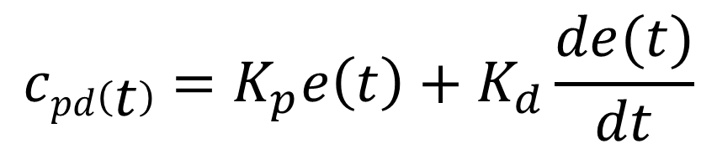


Proportional Plus derivative Control (PD)
$$K_{d}\frac{d}{dt}$$
$$K_{d}\frac{de(t)}{dt}$$
+
$$r(t)$$
$$e(t)$$
$$K_{p}e(t)$$
+
$$cpd\left(t\right)$$
$$K_{p}$$
$$Plant$$
$$c(t)$$
-
$$b(t)$$
$$Feedback$$
$$cpd\left(t\right)=K_{p}e\left(t\right)+K_{d}\frac{de(t)}{dt}$$

Slide 15
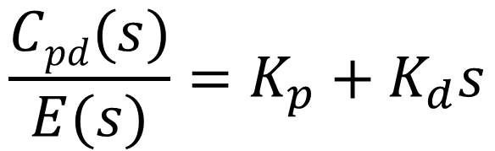
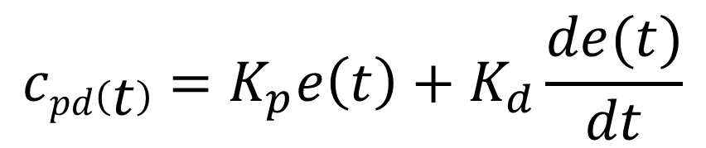
Proportional Plus derivative Control (PD)
$$cpd\left(t\right)=K_{p}e\left(t\right)+K_{d}\frac{de(t)}{dt}$$
The transfer function can be written as
$${\frac{Cpd(s)}{E(s)}=K}_{p}+K_{d}s$$

Slide 16
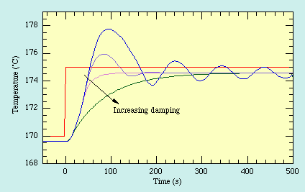
Proportional Plus derivative Control (PD)
The stability and overshoot problems that arise when a proportional controller is used at high gain can be mitigated by adding a term proportional to the time-derivative of the error signal. The value of the damping can be adjusted to achieve a critically damped response.

Slide 17
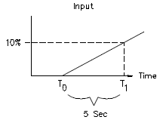
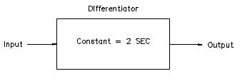
Proportional Plus derivative Control (PD)
The higher the error signal rate of change, the sooner the final control element is positioned to the desired value.
The added derivative action reduces initial overshoot of the measured variable, and therefore aids in stabilizing the process sooner.
This control mode is called proportional plus derivative (PD) control because the derivative section responds to the rate of change of the error signal

Slide 18


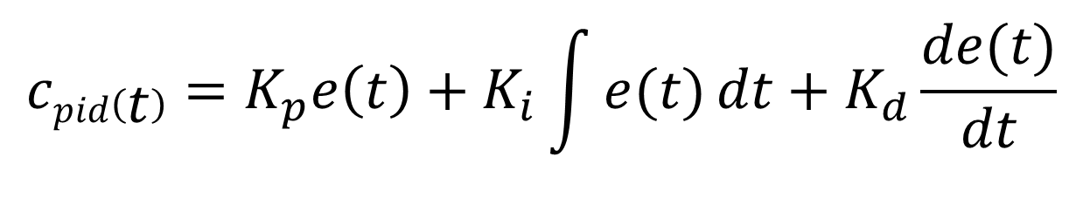


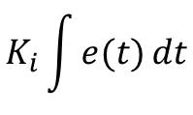



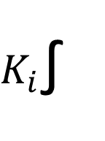




Proportional Plus Integral Plus Derivative Control (PID)
$$K_{d}\frac{d}{dt}$$
$$K_{d}\frac{de(t)}{dt}$$
+
$$r(t)$$
$$e(t)$$
$$K_{p}e(t)$$
+
$$cpid\left(t\right)$$
$$K_{p}$$
$$Plant$$
$$c(t)$$
-
+
$$b(t)$$
$$K_{i}\int{e(t)}dt$$
$K_{i}$∫
$$Feedback$$
$$cpid\left(t\right)=K_{p}e\left(t\right)+K_{i}\int{e(t)}dt+K_{d}\frac{de(t)}{dt}$$

Slide 19
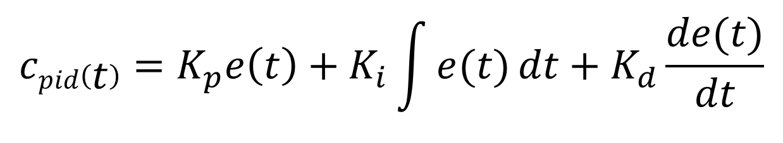
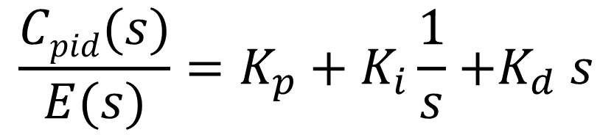
Proportional Plus Integral Plus Derivative Control (PID)
$$cpid\left(t\right)=K_{p}e\left(t\right)+K_{i}\int{e(t)}dt+K_{d}\frac{de(t)}{dt}$$
$${\frac{Cpid(s)}{E(s)}=K}_{p}+K_{i}\frac{1}{s}{+K}_{d}s$$

Slide 20
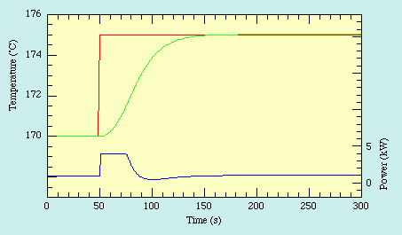
Proportional Plus Integral Plus Derivative Control (PID)
Although PD control deals neatly with the overshoot and ringing problems associated with proportional control it does not cure the problem with the steady-state error. Fortunately it is possible to eliminate this while using relatively low gain by adding an integral term to the control function which becomes

Slide 21
The Characteristics of P, I, and D controllers
CL RESPONSE
RISE TIME
OVERSHOOT
SETTLING TIME
S-S ERROR
Kp
Decrease
Increase
Small Change
Decrease
Ki
Decrease
Increase
Increase
Eliminate
Kd
Small Change
Decrease
Decrease
Small Change

Slide 22
Tips for Designing a PID Controller
1. Obtain an open-loop response and determine what needs to be improved
2. Add a proportional control to improve the rise time
3. Add a derivative control to improve the overshoot
4. Add an integral control to eliminate the steady-state error
Adjust each of K_{p}, K_{i}, and K_{d} until you obtain a desired overall response.
Lastly, please keep in mind that you do not need to implement all three controllers (proportional, derivative, and integral) into a single system, if not necessary. For example, if a PI controller gives a good enough response (like the above example), then you don't need to implement derivative controller to the system. Keep the controller as simple as possible.

Slide 23
PID Tuning Rules
Part-II

Slide 24
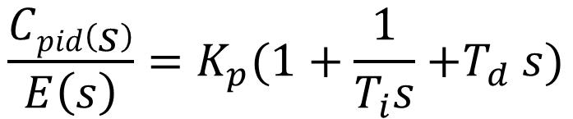
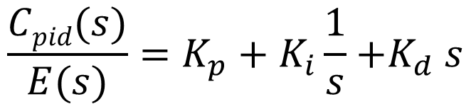


PID Tuning
The transfer function of PID controller is given as
It can be simplified as
Where
$${\frac{Cpid(s)}{E(s)}=K}_{p}+K_{i}\frac{1}{s}{+K}_{d}s$$
$${\frac{Cpid\left(s\right)}{E\left(s\right)}=K}_{p}(1+\frac{1}{T_{i}s}{+T}_{d}s)$$
$$T_{i}=\frac{K_{p}}{K_{i}}$$
$$T_{d}=\frac{K_{d}}{K_{p}}$$

Slide 25
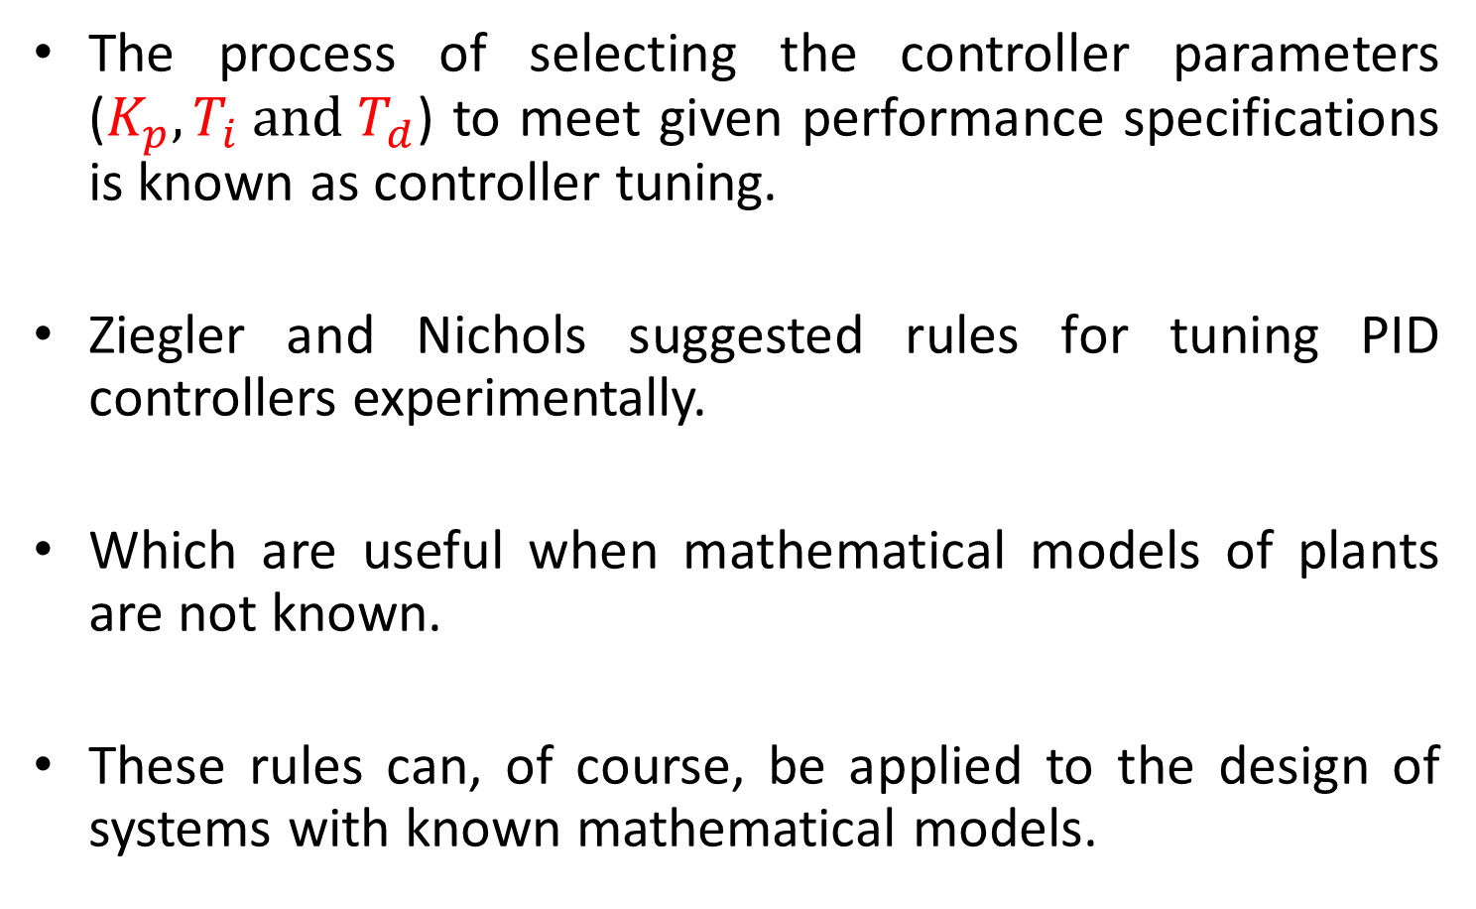
PID Tuning
The process of selecting the controller parameters ($K_{p}, T_{i} and T_{d}$) to meet given performance specifications is known as controller tuning.
Ziegler and Nichols suggested rules for tuning PID controllers experimentally.
Which are useful when mathematical models of plants are not known.
These rules can, of course, be applied to the design of systems with known mathematical models.

Slide 26
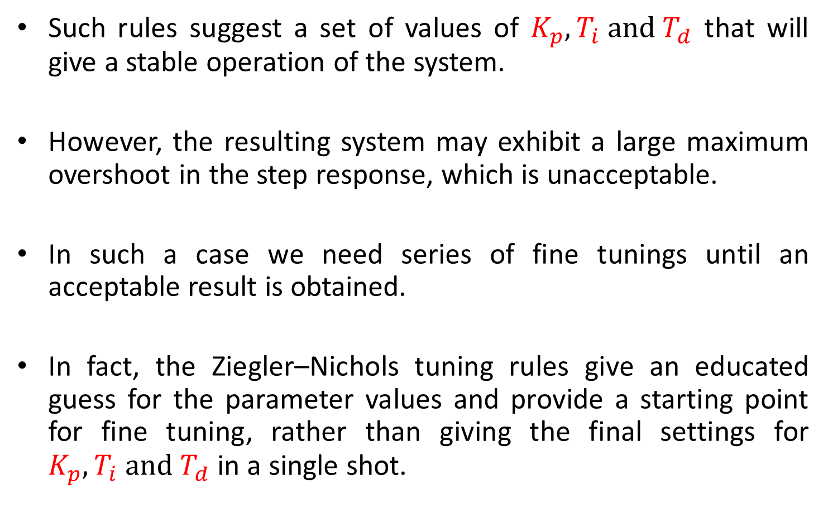
PID Tuning
Such rules suggest a set of values of $K_{p}, T_{i} and T_{d}$ that will give a stable operation of the system.
However, the resulting system may exhibit a large maximum overshoot in the step response, which is unacceptable.
In such a case we need series of fine tunings until an acceptable result is obtained.
In fact, the Ziegler–Nichols tuning rules give an educated guess for the parameter values and provide a starting point for fine tuning, rather than giving the final settings for $K_{p}, T_{i} and T_{d}$ in a single shot.

Slide 27
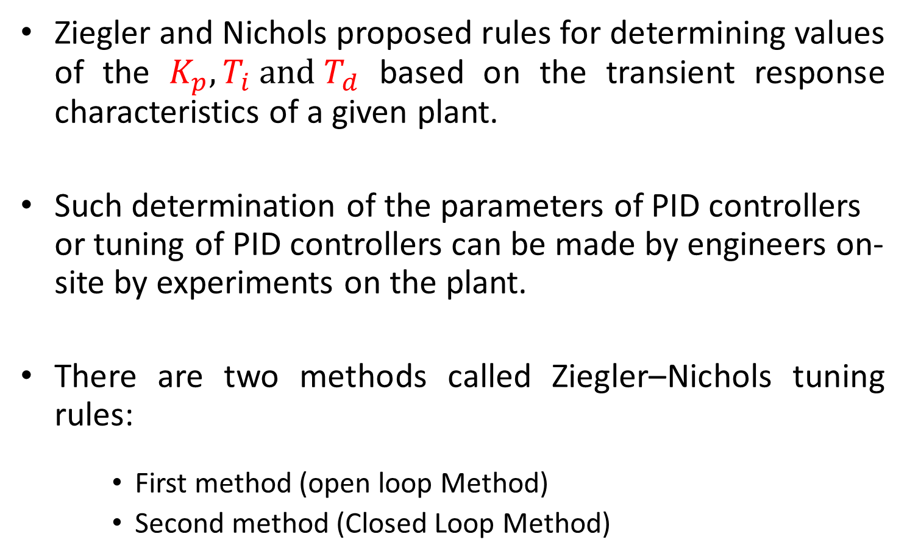
Zeigler-Nichol’s PID Tuning Methods
Ziegler and Nichols proposed rules for determining values of the $K_{p}, T_{i} and T_{d}$ based on the transient response characteristics of a given plant.
Such determination of the parameters of PID controllers or tuning of PID controllers can be made by engineers on-site by experiments on the plant.
There are two methods called Ziegler–Nichols tuning rules:
First method (open loop Method)
Second method (Closed Loop Method)

Slide 28
Zeigler-Nichol’s First Method
In the first method, we obtain experimentally the response of the plant to a unit-step input.
If the plant involves neither integrator(s) nor dominant complex-conjugate poles, then such a unit-step response curve may look S-shaped

Slide 29
Zeigler-Nichol’s First Method
This method applies if the response to a step input exhibits an S-shaped curve.
Such step-response curves may be generated experimentally or from a dynamic simulation of the plant.
Table-1

Slide 30
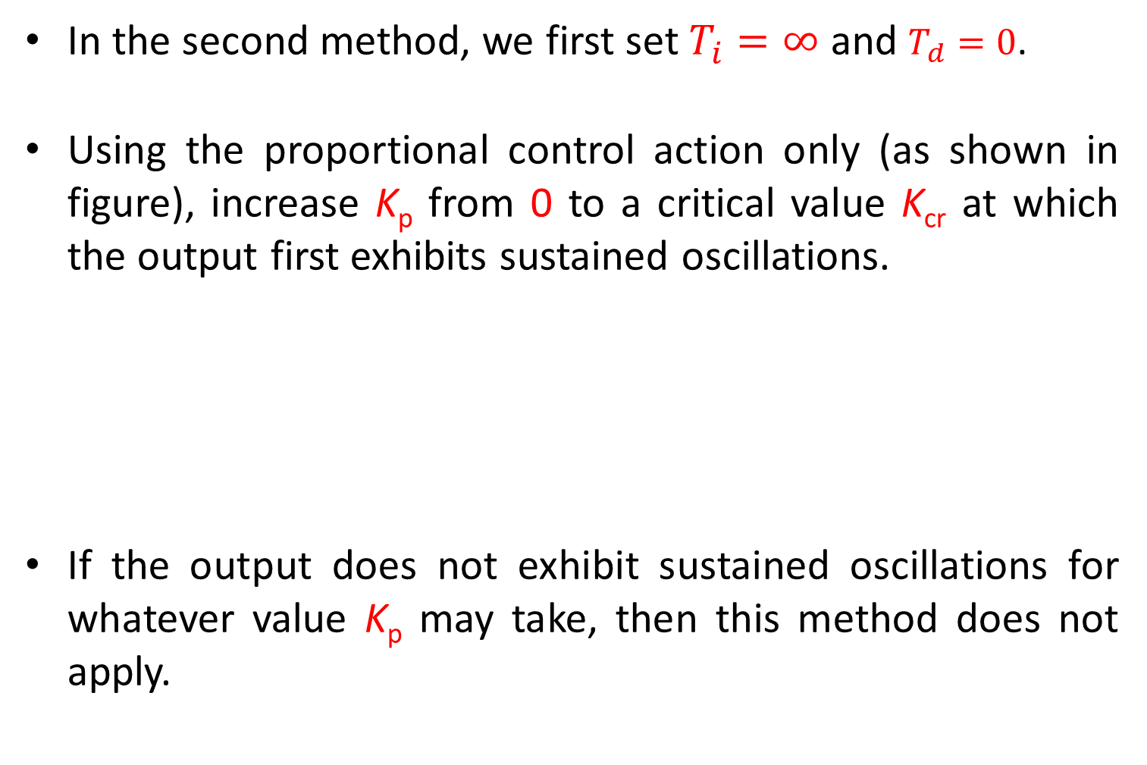
Zeigler-Nichol’s Second Method
In the second method, we first set $T_{i}=∞$ and $T_{d}=0$.
Using the proportional control action only (as shown in figure), increase K_{p} from 0 to a critical value K_{cr} at which the output first exhibits sustained oscillations.
If the output does not exhibit sustained oscillations for whatever value K_{p} may take, then this method does not apply.

Slide 31
Zeigler-Nichol’s Second Method
Thus, the critical gain K_{cr} and the corresponding period P_{cr} are determined.
Table-2

Slide 32
Example-1
1
t
L

Slide 33
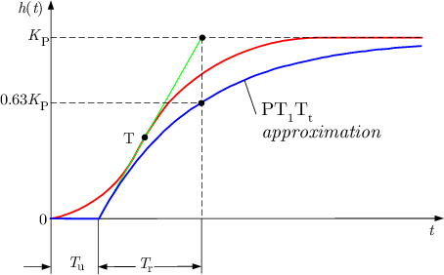
Example-1

Slide 34
Example-1

Slide 35

Example-2
Consider the control system shown in following figure.
Apply a Ziegler–Nichols tuning rule for the determination of the values of parameters $K_{p}, T_{i} and T_{d}$.

Slide 36
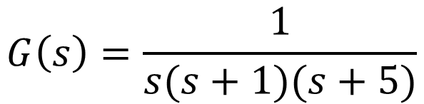
Example-2
Transfer function of the plant is
Since plant has an integrator therefore Ziegler-Nichol’s first method is not applicable.
According to second method proportional gain is varied till sustained oscillations are produced.
That value of K_{c} is referred as K_{cr}.
$$G\left(s\right)=\frac{1}{s(s+1)(s+5)}$$

Slide 37
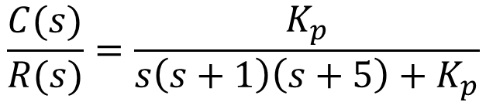
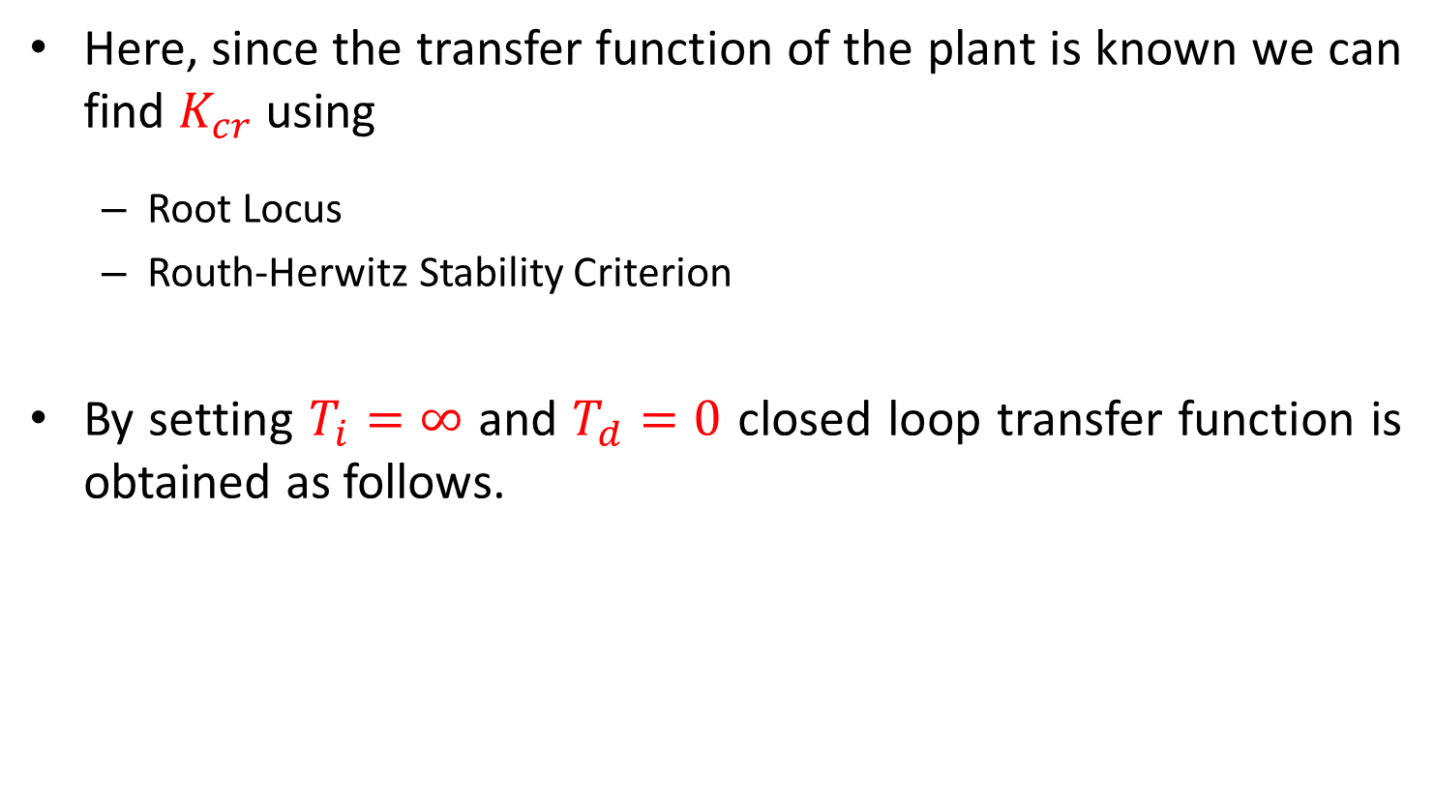

Example-2
Here, since the transfer function of the plant is known we can find $K_{cr}$ using
Root Locus
Routh-Herwitz Stability Criterion
By setting $T_{i}=∞$ and $T_{d}=0$ closed loop transfer function is obtained as follows.
$$K_{p}$$
$$\frac{C(s)}{R(s)}=\frac{K_{p}}{s\left(s+1\right)\left(s+5\right)+K_{p}}$$

Slide 38



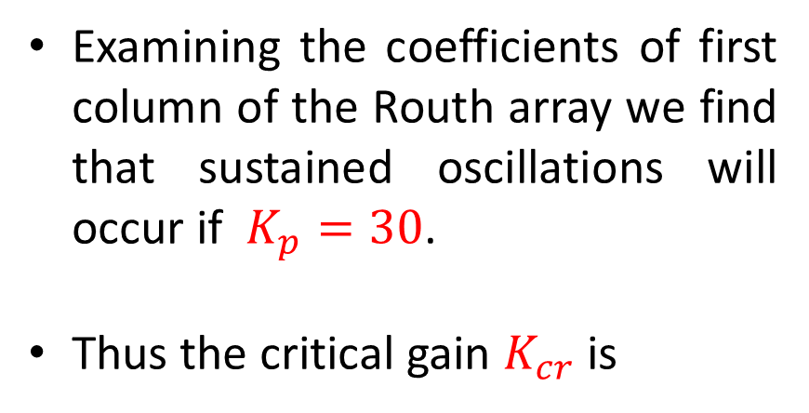
Example-2
The value of $K_{p}$ that makes the system marginally unstable so that sustained oscillation occurs can be obtained as
The Routh array is obtained as
$$s^{3}+6s^{2}+5s+K_{p}=0$$
Examining the coefficients of first column of the Routh array we find that sustained oscillations will occur if $K_{p}=30$.
Thus the critical gain $K_{cr}$ is
$$K_{cr}=30$$

Slide 39


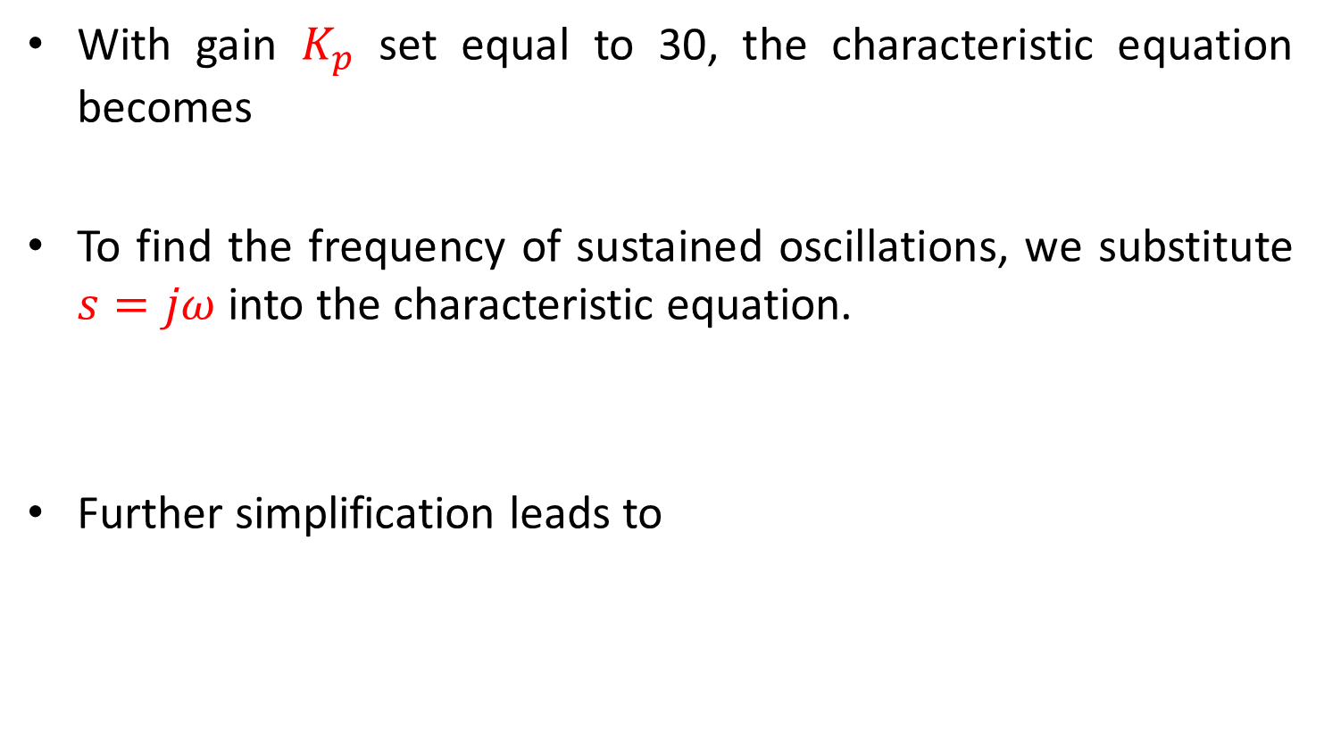

Example-2
With gain $K_{p}$ set equal to 30, the characteristic equation becomes
To find the frequency of sustained oscillations, we substitute $s=jω$ into the characteristic equation.
Further simplification leads to
$$s^{3}+6s^{2}+5s+30=0$$
$${(jω)}^{3}+6{(jω)}^{2}+5jω+30=0$$
$${6(5−ω}^{2})+jω{(5−ω}^{2})=0$$
$${6(5−ω}^{2})=0$$
$$ω=\sqrt{5} rad/sec$$

Slide 40


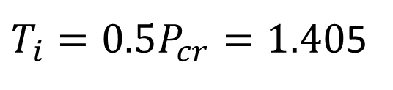


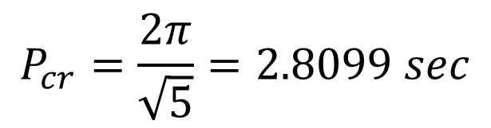
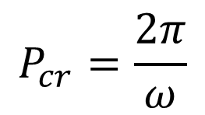
Example-2
$$ω=\sqrt{5} rad/sec$$
Hence the period of sustained oscillations $P_{cr}$ is
Referring to Table-2
$$P_{cr}=\frac{2π}{ω}$$
$$P_{cr}=\frac{2π}{\sqrt{5}}=2.8099 sec$$
$$K_{p}=0.6K_{cr}=18$$
$T_{i}=0.5P_{cr}=1.40$5
$$T_{d}=0.125P_{cr}=0.35124$$

Slide 41
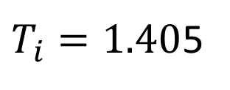

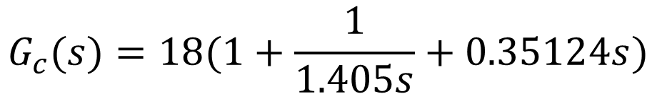
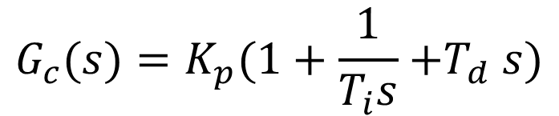

Example-2
$$K_{p}=18$$
$T_{i}=1.40$5
$$T_{d}=0.35124$$
Transfer function of PID controller is thus obtained as
$${G_{c}(s)=K}_{p}(1+\frac{1}{T_{i}s}{+T}_{d}s)$$
$$G_{c}(s)=18(1+\frac{1}{1.405s}+0.35124s)$$

Slide 42
Example-2

Slide 43
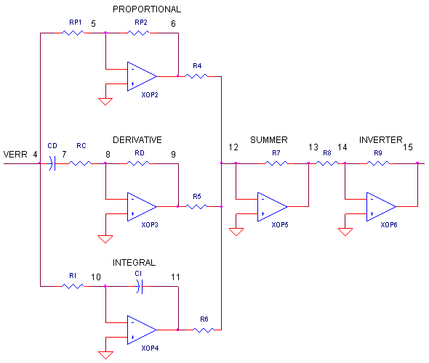

















Electronic PID Controller
$$R_{1}$$
$$R_{2}$$
$$K_{p}=−\frac{R_{2}}{R_{1}}$$
$$R_{3}$$
$$T_{d}=−R_{D2}C_{D}$$
$$T_{i}=−R_{I}C_{I}$$
$$C_{D}$$
$$e(t)$$
$$R_{D2}$$
$$R_{D1}$$
$$R_{6}$$
$$R_{7}$$
$$R_{8}$$
$$R_{4}$$
$$R_{I}$$
$$C_{I}$$
$$R_{5}$$

Slide 44
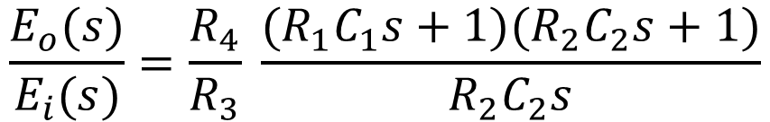
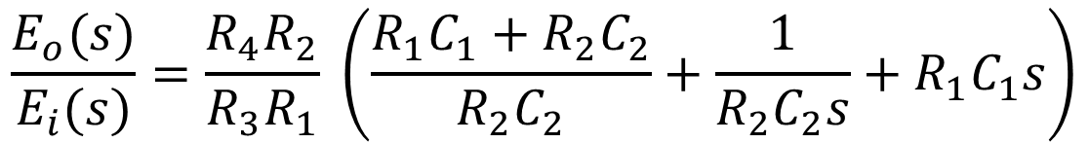
Electronic PID Controller
$$\frac{E_{o}(s)}{E_{i}(s)}=\frac{R_{4}}{R_{3}} \frac{(R_{1}C_{1}s+1)(R_{2}C_{2}s+1)}{R_{2}C_{2}s}$$
$$\frac{E_{o}(s)}{E_{i}(s)}=\frac{R_{4}R_{2}}{R_{3}R_{1}} \left(\frac{R_{1}C_{1}+R_{2}C_{2}}{R_{2}C_{2}}+\frac{1}{R_{2}C_{2}s}+R_{1}C_{1}s\right)$$

Slide 45







Electronic PID Controller
$$\frac{E_{o}(s)}{E_{i}(s)}=\frac{R_{4}R_{2}}{R_{3}R_{1}} \left(\frac{R_{1}C_{1}+R_{2}C_{2}}{R_{2}C_{2}}+\frac{1}{R_{2}C_{2}s}+R_{1}C_{1}s\right)$$
$$\frac{E_{o}(s)}{E_{i}(s)}=\frac{R_{4}\left(R_{1}C_{1}+R_{2}C_{2}\right)}{R_{3}R_{1}C_{2}}\left[1+\frac{1}{\left({R_{1}C_{1}+R}_{2}C_{2}\right)s}+\frac{R_{1}C_{1}R_{2}C_{2}}{R_{1}C_{1}{+R}_{2}C_{2}}s\right]$$
$$K_{p}=\frac{R_{4}\left(R_{1}C_{1}+R_{2}C_{2}\right)}{R_{3}R_{1}C_{2}}$$
$$T_{d}=\frac{R_{1}C_{1}R_{2}C_{2}}{R_{1}C_{1}{+R}_{2}C_{2}}$$
$$T_{i}={R_{1}C_{1}+R}_{2}C_{2}$$
In terms of K_{p}, K_{i}, K_{d} we have
$$K_{p}=\frac{R_{4}\left(R_{1}C_{1}+R_{2}C_{2}\right)}{R_{3}R_{1}C_{2}}$$
$$K_{i}=\frac{R_{4}}{{R_{3}R}_{1}C_{2}}$$
$$K_{d}=\frac{R_{4}R_{2}C_{1}}{R_{3}}$$

